Slide 1
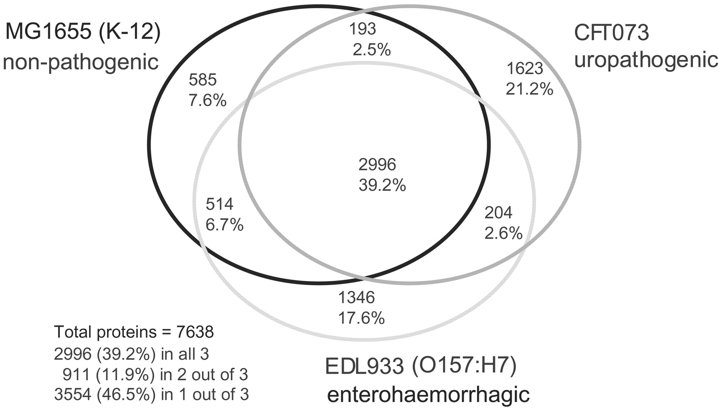
Welch RA, et al. Proc Natl Acad Sci U S A. 2002; 99:17020-4
Escherichia coli, strain CFT073, uropathogenic
Escherichia coli, strain EDL933, enterohemorrhagic Escherichia coli K12, strain MG1655, laboratory strain,
“… only 39.2% of their combined (nonredundant) set of proteins actually are common to all three strains.”

Slide 2
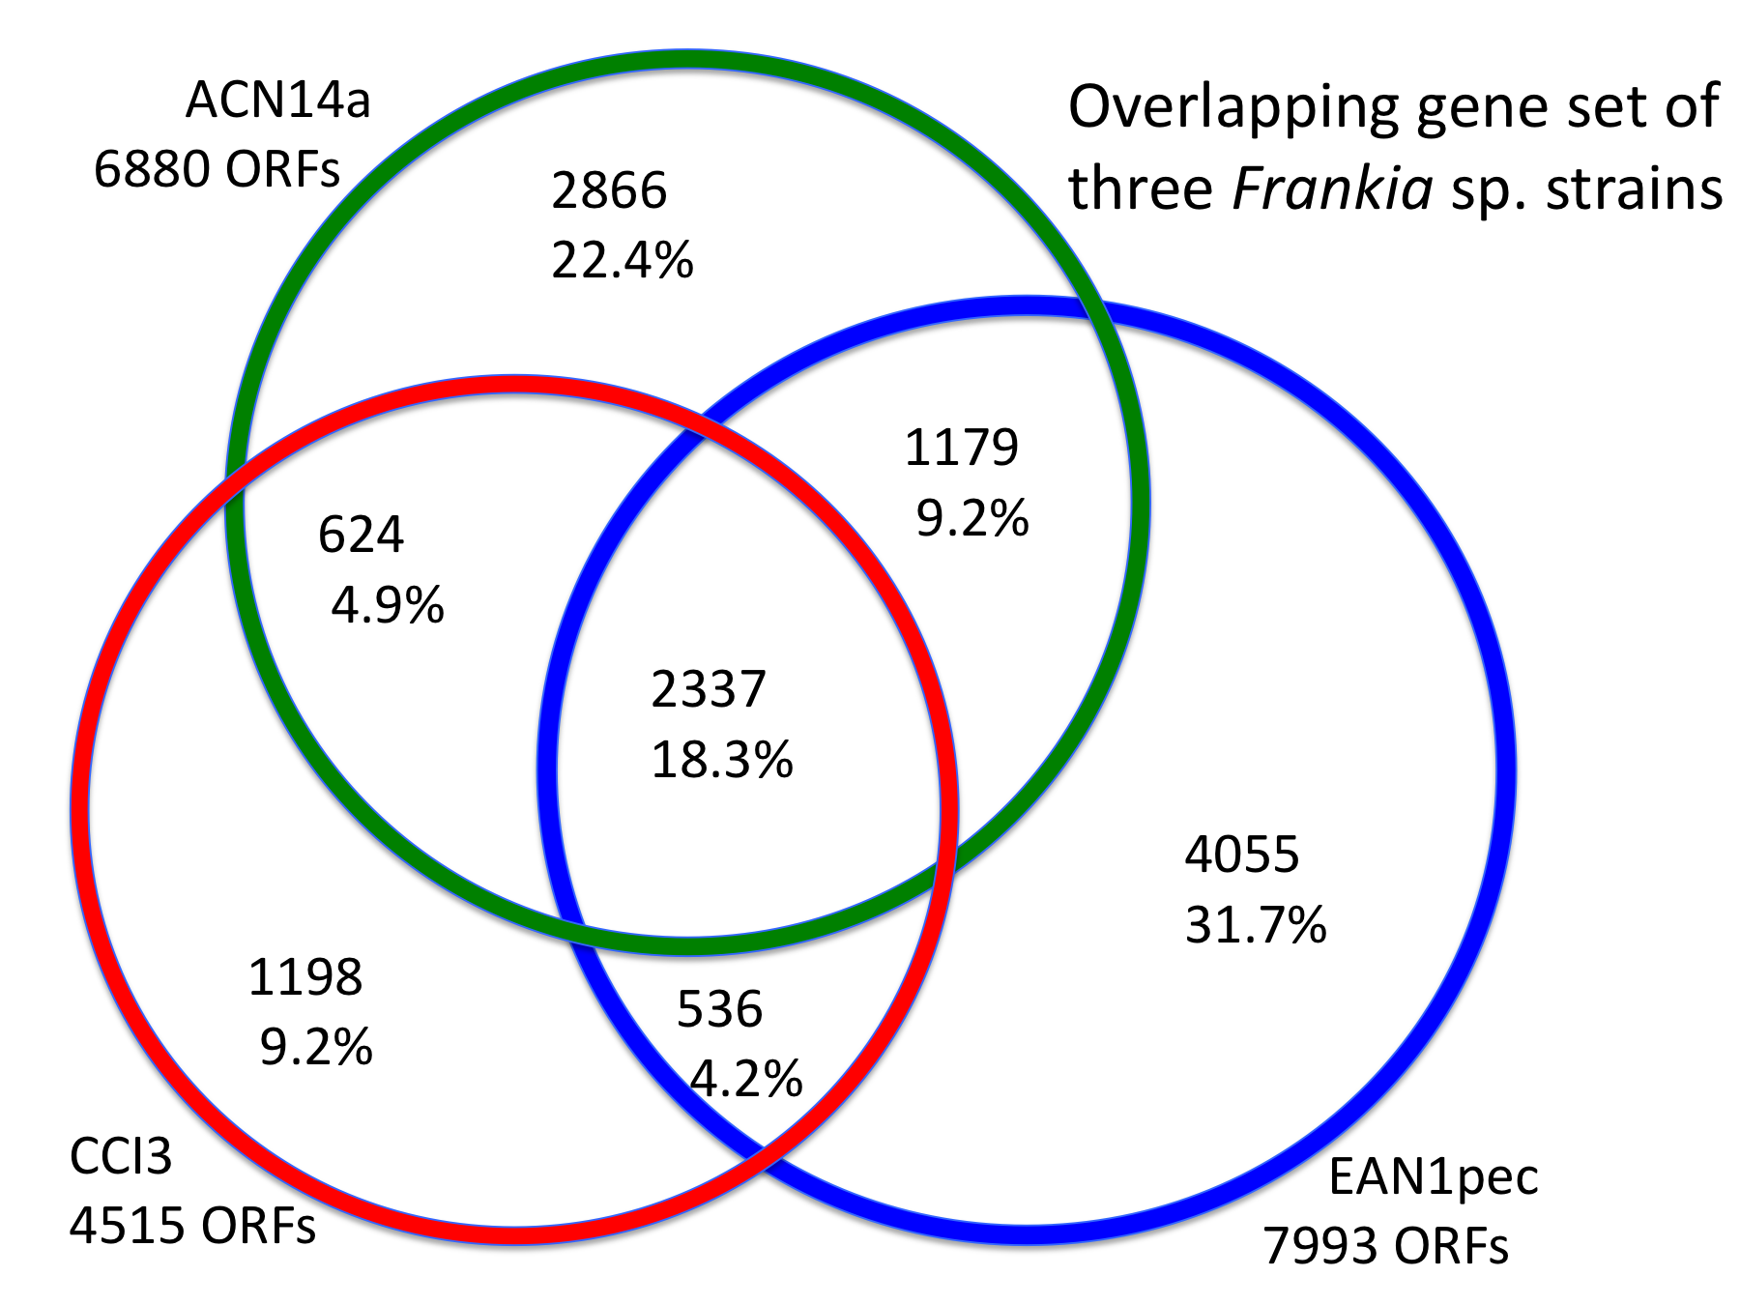
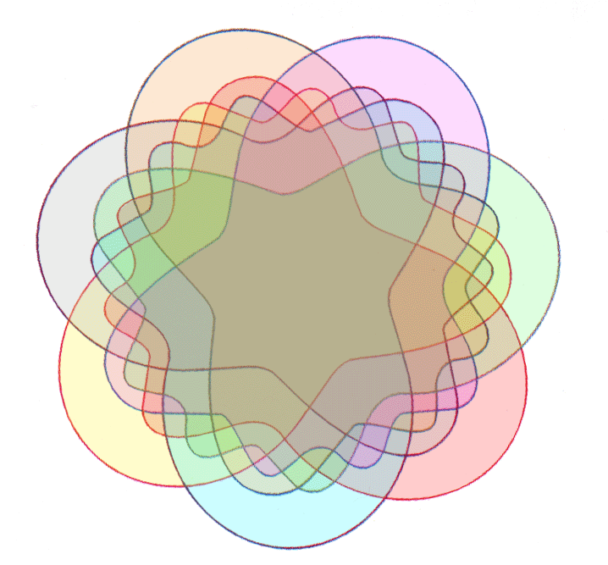
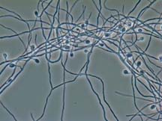
GENOMES OF CLOSELY RELATED ORGANISMS: CORE AND SHELL
From: Normand et al. (2007) Genome Research 17: 7-15
Strain-specific
Dispensable
core
Edwards-Venn cogwheel
A.W.F. Edwards 1998
Dispensable
Image
source:
web.uconn.edu/mcbstaff/benson/Frankia/FrankiaHome.htm

Slide 3
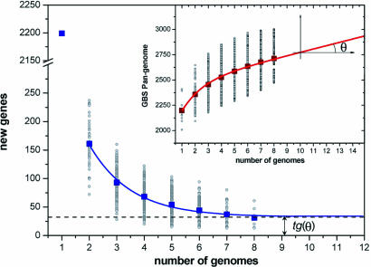
Description of Group B Streptococcus Pan-genome
Genome comparisons of 8 closely related GBS strains
Tettelin, Fraser et al., PNAS 2005 Sep 27;102(39)

Slide 4
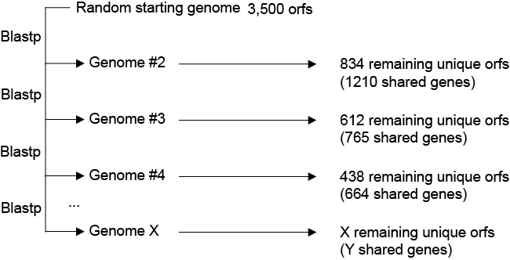
Method

Slide 5
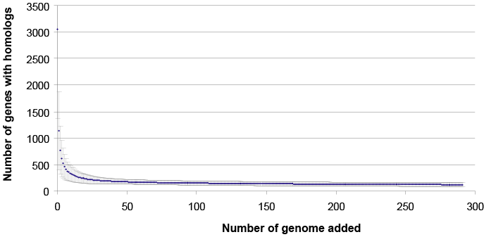
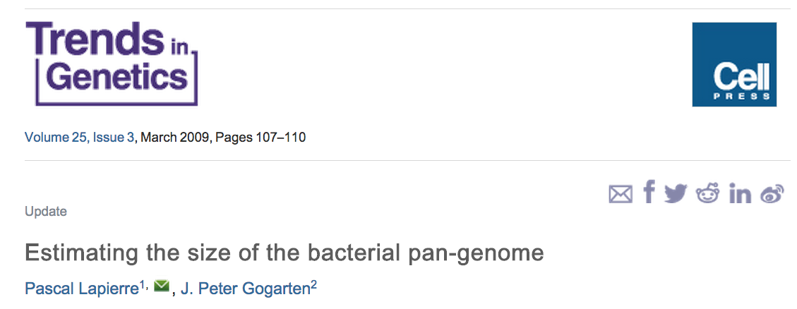
Bacterial Core
Genes that are shared among all Bacteria
Bit score cutoff 50.0 (~10E⁻⁴)
f(x) = A₁*exp^{(-K1*x)} + A₂*exp^{(-K2*x)} + A₃*exp^{(-K3*x)} + Plateau

Slide 6
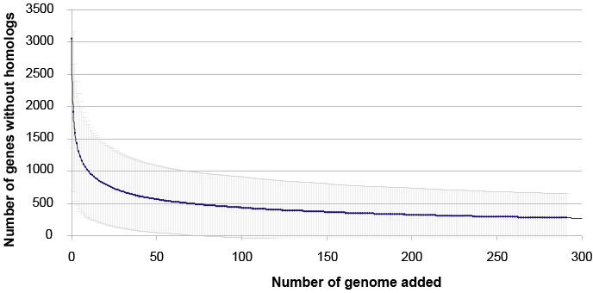
Genes without homologs
f(x) = A₁*exp^{(-K1*x)} + A₂*exp^{(-K2*x)} + A₃*exp^{(-K3*x)} + A₄*exp^{(-K4*x)}
+ A₅*exp^{(-K5*x)} + Plateau

Slide 7
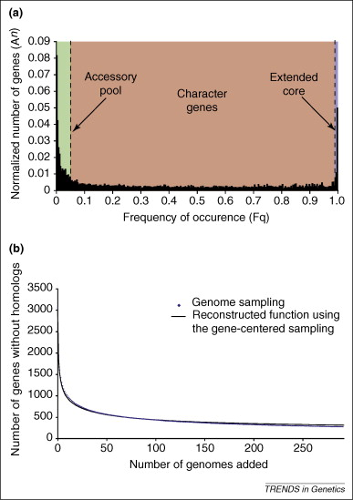

Slide 8
Core
Extended Core
Accessory Pool
Essential genes
(Replication, energy, homeostasis)
Set of genes that define groups or species
(Symbiosis,
photosynthesis)
Genes that can be used to distinguish strains or serotypes
(Mostly genes of unknown functions)
~ 116 gene
families
~ 17,060 gene
families
~ 114,800 gene
Families uncovered so far

Slide 9
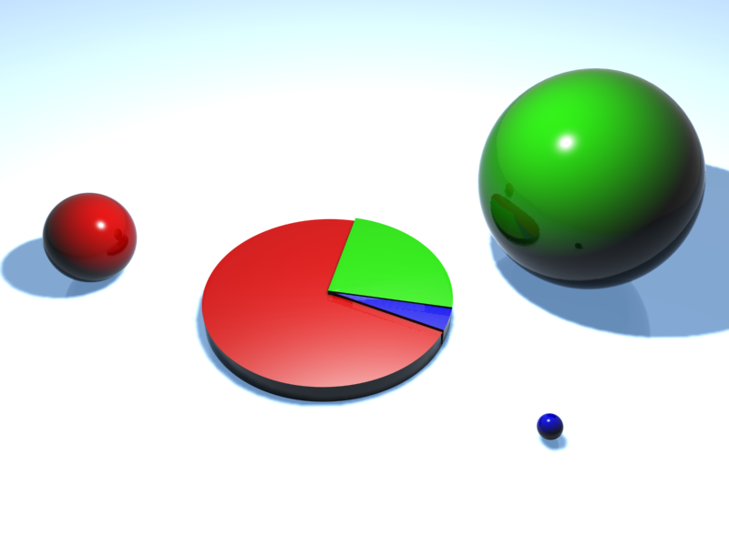
Gene frequency in individual genomes
Accessory Pool
Extended Core
19.6%
76.6%
3.8%
Core

Slide 10
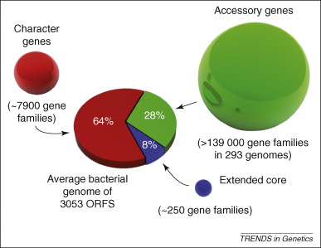
Figure 2 The bacterial pan-genome. Each gene found in the bacterial genome represents one of three pools: genes found in all but a few bacterial genomes comprise the extended core of essential genes (∼250 gene families that encode proteins involved in tran...
Pascal Lapierre , J. Peter Gogarten
Estimating the size of the bacterial pan-genome
Trends in Genetics, Volume 25, Issue 3, 2009, 107 - 110
http://dx.doi.org/10.1016/j.tig.2008.12.004

Slide 11
A Kézdy-Swinbourne Plot plot can be used to estimate the value that a decay function approaches as time goes to infinity.
Assume the simple decay function
f(x) = K + A e^{-kx} , then f(x + ∆x) = K + A e^{-k(x+∆x)}.
Through elimination of A:
f(x+∆x)=e^{-k ∆x} f(x) + K’
For the plot of f(x+∆x) against f(x) the slope is e^{-k ∆x}. For x→∞
both f(x) and f(x+∆x) approach the same constant : f(x)→K, f(x+∆x)→K. (see the def. for the decay function)
The Kézdy-Swinbourne Plot is rather insensitive to deviations from a simple single component decay function.
More at Hiromi K: Kinetics of Fast Enzyme Reactions. New York: Halsted Press (Wiley); 1979

Slide 12
Kézdy-Swinbourne Plot
If f(x)=K+A • exp(-k•x), then
f(x+∆x)=K+A • exp(-k•(x+∆x)).
Through elimination of A:
f(x+∆x)=exp(-k • ∆x) • f(x) + K’
And for x→∞, f(x)→K, f(x+∆x)→K (blue arrow)
Novel genes after looking in x + ∆x genomes
~230 novel genes per genome
For each line:
Slope = exp(-k• ∆x)
Both the value at infinity (time or number of genomes) = K and the decay constant k can be estimated!
Novel genes after looking in x genomes
only values with x ≥ 80 genomes were included
Even after comparing to a very large (infinite) number of bacterial genomes, on average, each new genome will contain about 230 genes that do not have a homolog in the other genomes.

